Slide 1
Lecture 8:
3.1. Commercial Revolutions
Brad DeLong
Department of Economics and Blum Center, U.C. Berkeley; WCEG; and NBER
last revised: 2020-02-06
for presentation: 2020-02-13
Original course by Melissa Dell (Harvard Econ 1342), revised by Brad DeLong, research assistance by Anish Biligiri
<https://github.com/braddelong/public-files/blob/master/econ-135-lecture-8.pptx>

Slide 2
Roadmap for the Next Week
7. Why Was Pre-Industrial Progress so Slow on Average? (Feb 13):
Read Before: Josh Ober (2019): Agamemnon's Cluelessness, selections <https://delong.typepad.com/files/ober-agamemnon-selections.pdf>
Read Before: Moses Finley: Technical Innovation and Economic Progress in the Ancient World <https://delong.typepad.com/finley-technical.pdf>
Slides: <https://github.com/braddelong/public-files/blob/master/econ-135-lecture-7.pptx>
Start: Assignment 5: Simulations with the Solow growth model; due Feb 19 <https://bcourses.berkeley.edu/courses/1487685/assignments/8065916>
8. Commercial Revolutions (Feb 18):
Read: Christopher Berry (2018): Adam Smith: A Very Short Introduction <https://delong.typepad.com/files/berry-smith.pdf>
Slides: <https://github.com/braddelong/public-files/blob/master/econ-135-lecture-8.pptx>
Finish: Assignment 5: Simulations with the Solow growth model; due Feb 19 <https://bcourses.berkeley.edu/courses/1487685/assignments/8065916>
9. Industrial Revolutions (Feb 20):
Read Before: Robert Allen (2017): The Industrial Revolution: A Very Short Introduction, selections <https://delong.typepad.com/files/allen-industrial.pdf>
Read Before: Joel Mokyr (1990): Lever of Riches, chapter 5 “The Years of Miracles” <https://delong.typepad.com/files/mokyr-lever-revolution.pdf>
Read Before: Karl Marx and Friedrich Engels (1848): The Communist Manifesto <https://www.marxists.org/archive/marx/works/download/pdf/Manifesto.pdf>
Slides: <https://github.com/braddelong/public-files/blob/master/econ-135-lecture-9.pptx>
Start: Assignment 6: slow technological and organizational progress before 1500 paper; due Mar 1
10. Exam (Feb 25):
Instructor Reality Check
60% short answers; 40% essay

Slide 3
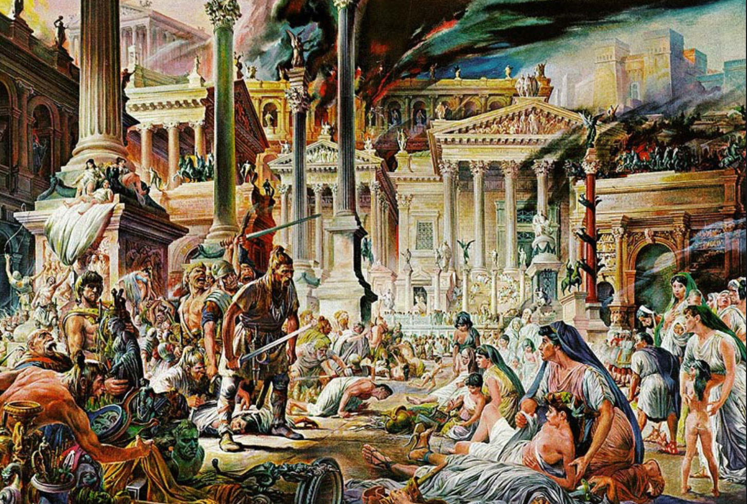
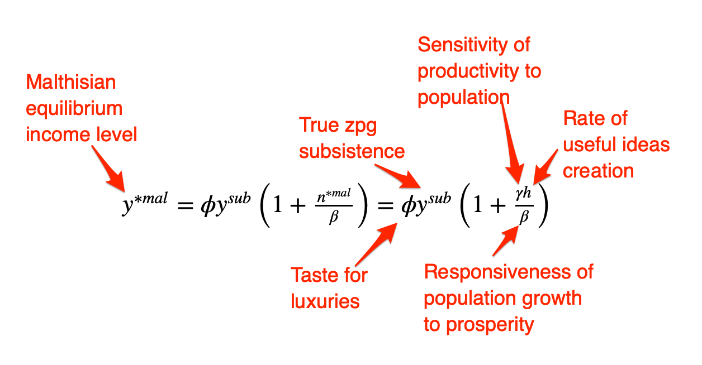
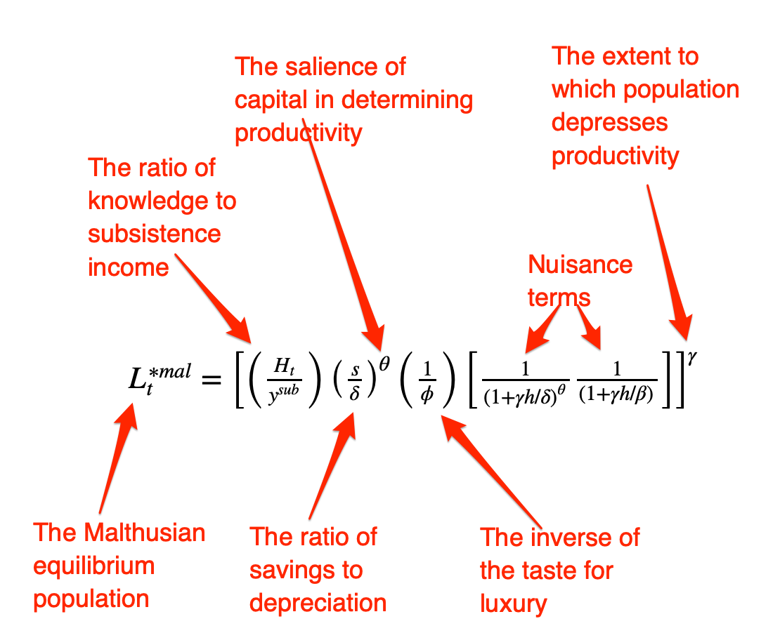
The Fall of Rome
Economic Zenith, Then Economic Decline, Then Political Decline:
While the existing data are somewhat contradictory, the consensus amongst archaeologists is the early 2nd century.
A new social distinction between honestiores (high status) and humiliores (low status with different laws) was introduced.
Citizens began to lose their rights and by the end of the 2nd century, they were being tied to the land as serfs
The Barbarians were at the gates, but it seems reasonable to see this as an outcome of the weakening of Roman institutions
Earlier Rome had defeated far more formidable and better organized enemies like the Carthaginians.
Acemoglu and Robinson argue that the big fact about what preceded the decline is that political institutions moved in a much more extractive direction and this was followed by economic institutions.
Jongman (“Gibbon was Right”) proposes that the Antonine plague which hit the Roman Empire around 160AD is the most likely explanation for the collapse of Rome.
But Malthusian crises are supposed to increase living standards, not reduce them: so what is going on?
Slide taken from Melissa Dell

Slide 4
Three Great Plagues
But the demands of the empire for revenue and of the upper class for resources remain the same:
Antonine Plague (smallpox?): Antonine ⇒ Severian dynasty
Plague of St. Cyrian (Ebola-like?): Things fall completely apart, then Diocletian: between Philip the Arab and Diocletian, 18 emperors in 35 years, plus two breakaways; 12 of the 18 were assassinated
Plague of Justinian (Bubonic): Flavius Apion…

Slide 5
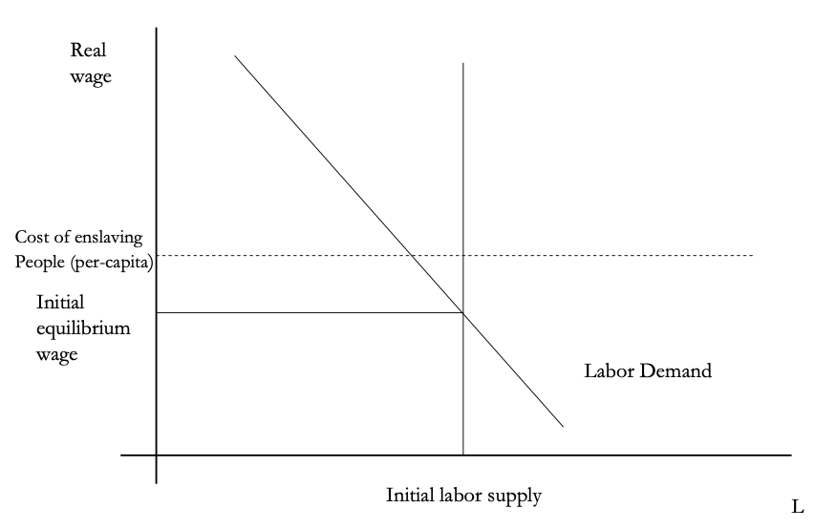
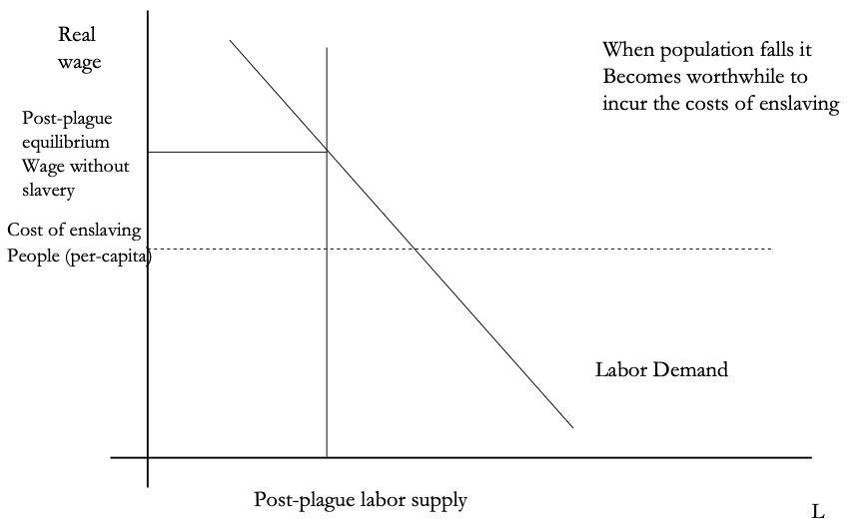
The Domar Hypothesis
You can have a leisured upper class, or abundant land relative to labor, or free labor, but not all three at once:
Slide taken from Melissa Dell

Slide 6
Dell’s Summary of Acemoglu and Robinson on the Rise and Fall of Rome
“Efflorescence” driven by good institutions:
Historically economic growth coincided with institutional innovation: creation of states with working political institutions that could provide public goods, law and order, encourage trade etc.
Functioning states could also raise taxes and fund armies, allowing widespread conquests.
However, they argue these were fundamentally extractive institutions, even if in some cases economic institutions were initially relatively inclusive.
They argue that extractive growth is not sustained because there is little technological change. Moreover, it naturally creates political instability which eventually destroys the institutions which started the growth.
Slide taken from Melissa Dell

Slide 7
The Later Roman Empire
How does it compare to the expanding Roman Republic?
Militarism: in striking contrast to earlier days, a successful general is a threat to the emperor. Eighteen emperors in 35 years between Philip the Arab and Diocletian
Mobilization: In order to extract resources from a smaller population, the people must be disarmed rather than mobilized.
Distribution: The smaller pool of benefits needs to be hoarded for those with connections, not shared.
Incorporation: You can join the Goths: you cannot join the Roman upper class unless you know someone…

Slide 8
Flavius Apion
Peter Sarris on Justinian I in 542:
Writing to his Praetorian Prefect concerning the army—trained and equipped and paid for by the Roman State to control the barbarians and to "increase the state." Peter Sarris reports in his Economy and Society in the Age of Justinian, upset that:
Certain individuals had been daring to draw away soldiers and foederati from their duties, occupying such troops entirely with their own private business.... The emperor... prohibit[ed] such individuals from drawing to themselves or diverting troops... having them in their household... on their property or estates.... Any individual who, after thirty days, continues to employ soldiers to meet his private needs and does not return them to their units will face conﬁscation of property... "and those soldiers and ﬁoderati who remain in paramonar attendance upon them... will not only be deprived of their rank, but also undergo punishments up to and including capital punishment."

Slide 9
Anoup
One of Flavius’s tenants and debtors, Anoup, wrote:
No injustice or wickedness has ever attached to the glorious household of my kind lord, but it is ever full of mercy and overflowing to supply the needs of others.
On account of this I, the wretched slave of my good lord, wish to bring it to your lordship's knowledge by this present entreaty for mercy that I serve my kind lord as my fathers and forefathers did before me and pay the taxes every year. And by the will of God... my cattle died, and I borrowed the not inconsiderable amount of 15 solidi....
Yet when I approached my kind lord and asked for pity in my straits, those belonging to my lord refused to do my lord's bidding. For unless your pity extends to me, my lord, I cannot stay on my ktema and fulfill my services with regard to the properties of the estate.
But I beseech and urge your lordship to command that mercy be shown to me because of the disaster that has overtaken me...

Slide 10
Not “Legible” to the State
Justinian knows very well that the countryside is not legible to him:
The contracts that Flavius Apion makes with his tenants are made under the shadow of the threat that if Flavius Apion does not like the way things are going he will send a bucellarius to beat you up.
Anoup is not pointing out to Flavius Apion that their landlord-tenant relationship is a good thing and that keeping him as a tenant rather than throwing him off the land for failure to pay the rent is in both their interests.
Instead, Anoup is calling himself a slave (which he is not). Anoup is calling Flavius Apion a lord (which he is not supposed to be). Anoup is appealing to a long family history of dependence of himself and his ancestors on the various Flavii Apionoi and Flavii Strategioi of past generations.
Justinian thinks that things would be better served if the countryside were properly legible to him and he could enforce reality to correspond to the legal order of slaves and citizens, tenants and landlords interacting through contract, and taxpayers.
Flavius Apion would prefer that the order be one of proto-feudalism: that all the Anoups know and understand that they are at his mercy, and that the emperor is far, far away.
And we don't know what Anoup thinks:
We do know that does not sound as though he experiences the lack of legibility of the countryside to the emperor and his state as a full and complete liberation.
And we do know that the Emperor Justinian was gravely concerned about the transformation of his soldiers into bucellarii, into the dependent bully-boys of the landlords—both because it meant that they were not on the borders where they belonged and because it disturbed what he saw as the proper balance of power in the countryside and what he saw as the emperor's justice.

Slide 11
Dell’s Summary of Acemoglu and Robinson on the Rise and Fall of Rome II
For the Roman Empire, the collapse of Roman authority was pronounced, particularly in the West:
By 450AD all the trappings of Roman economic prosperity were gone.
Money vanished from circulation.
Urban areas were abandoned and buildings stripped of stone.
The roads were overgrown with weeds.
The only type of pottery which was fabricated was crude and hand made, not manufactured.
People forgot how to use mortar and they also forgot how to read and write.
Roofs were made of branches, not tiles.
The Eastern Roman Empire lived on, but it contracted significantly with the rise of Islam in the 7th Century.
Slide taken from Melissa Dell

Slide 12
Subsequent Evolution of Western Europe
Land Ownership and Exploitation in a Nutshell:
Peter Temin: Land Tenure and Exploitation from the Roman Empire to Lord Peter Wimsey <https://www.bradford-delong.com/2020/02/weekend-reading-peter-temin-land-tenure-and-exploitation-from-the-roman-empire-to-lord-peter-wimsey.html>...

Slide 13
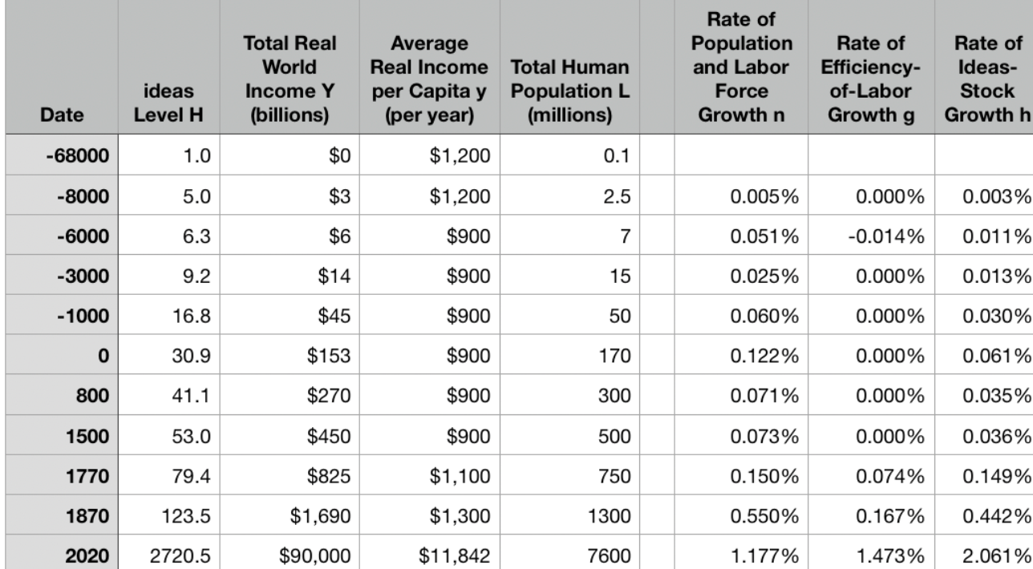
Why Was Pre-Industrial Progress so Slow on Average?
Our readings:
Willem M. Jongman (2007): Gibbon was Right: The Decline and Fall of the Roman Economy <https://delong.typepad.com/jongman-gibbon-was-right.pdf>
Peter Temin: The Roman Market Economy, Roman Growth <https://delong.typepad.com/files/temin-roman-growth.pdf>
Moses Finley: Technical Innovation and Economic Progress in the Ancient World <https://delong.typepad.com/finley-technical.pdf>
Josh Ober (2019): Agamemnon's Cluelessness, selections <https://delong.typepad.com/files/ober-agamemnon-selections.pdf>

Slide 14
Potential Points of View
What are the possibilities here?:
No puzzle—given how few heads they had, and given the absence of printing and the difficulty of controlled experiments, it is a miracle that they managed to advance technology as far as they did as fast as they did…
No: there was something wrong. They had the wrong kind of society…
No: something went wrong: civilization seems to be progressing up to the year 1… 0.013%/yr… 0.030%/yr… 0.061%/yr… & then it stalls out: instead of doubling to a Commercial Revolution rate of growth after the year 1, the rate of ideas growth halves again…

Slide 15
Our Four Readings I
What possibilities do they argue for?:
Jongman:
“Population went down… production per man hour must have gone up….. Conversely, rents must have gone therefore the incomes of elite land-owners. The Roman Empire should have turned into a world of happy and prosperous peasants, and much greater social equality than before. The theory is impeccable, but reality was, of course, different. What we witness from the late second century is the emergence of a new social, political, and legal regime, where oppression replaces the entitlements of citizenship…”
Temin:
“The high ratio of wages to energy costs was not only absent in eighteenth-century continental Europe; it was absent as well in the Roman Empire. Despite the technical progress being made then that we are discovering more about, there was no possibility of escaping from the Malthusian constraints with the price ratios that existed then. However prosperous Rome may have been, it was not on the verge of having an Industrial Revolution. There was no analog of the British coal industry in antiquity and therefore no possibility that industrialization could have begun in the ancient world.

Slide 16
Our Four Readings II
What possibilities do they argue for?:
Finley:
“The pejorative judgments of ancient writers about labour, and specifically about the labour of the artisan, and of anyone who worksfor another, are too continuous, numerous, and unanimous, too wrapped up in discussions of every aspect of ancient life, to be dismissed as empty rhetoric. In other slave-owning societies for whom there is fuller documentation, these implications and their practical effects are unmistakable.
“Writing about the Great Trek, for example, Sir Keith Hancock said: 'The Boers very soon convinced themselves that artisans' work and slaves' work were the same thing—a conviction which struck such deep roots in their minds that their descendants in the nineteenth century left to British immigrants almost all the opportunities of skilled industrial employment in the expanding towns'.
“Or Tocqueville, whose I83I notebooks are filled with the theme that 'slavery is even more prejudicial to the masters than to the slaves', because, as a leading Louisville merchant said to him, 'it deprives us of the energy and spirit of enterprise that characterizes the States that have no slaves’.
“Greek and Roman slavery functioned in a different context, to be sure, both internally and externally, and comparisons must be made with caution and reserve. But this particular one seems to me to be valid and necessary…”
“Nothing that I have said should be taken to suggest that there was no technical or economic progress whatever in antiquity. Obviously the range and quality of products were enhanced and standards of life rose, at least for the rich. The spread of urbanization suggests, and the quality of urban living confirms, that a larger share of the total income was available for non-productive expenditure…”

Slide 17
Our Four Readings III
What possibilities do they argue for?:
Ober:
“If the 'substantial growth’ conclusion is correct, as I suppose it to be, it appears that in practice, at least, Greeks were quite capable of the kind of reasoning necessary to build and sustain a growing economy. That is to say, ancient Greeks, as individuals and collectives, frequently employed economic rationality, i.e. rationally instrumental reasoning in economic contexts. It is nonetheless undeniable that there is a body of classical literature that exemplifies the scorn for money-making that was emphasized by the Finley school. Those expressions of scorn underpin the theory of an essentially timeless and changeless ancient economy predicated on violent extraction and gift exchange.
“The many surviving works of classical-era Socratics—Plato, Xenophon, and Aristotle—figure prominently in that ancient body of evidence. While scorn for trade and commerce can indeed be found outside the philosophical corpus, absent the works of the Socratic philosophers, our sense of what ‘Greek literature’ has to say about economic activity would be very different.”
“The approach of the Socratic philosophers to economic rationality was fundamentally critical and normative…. For Finley and his school, social status remained foundational; any activity that was not grounded in status, and in the power relations thought to inhere in status relations, was, consequently, unmoored and ephemeral.
“Economic activity aimed at increasing productivity, innovations aimed at increasing efficiency, and increased consumption—rather than securing the status of the relevant actors—were, thereby, rendered more or less invisible—and in any event, unworthy of detailed study. The result was, so I suppose, both a misunderstanding of the relevant texts and a misrepresentation of the underlying social reality…”

Slide 18
Review: What Should We Review Today?
A number of possibilities:
The grand overview of the history of economic growth
Models:
The Solow growth model
Malthusian forces
“Two heads (almost) twice as good as one” & “low-hanging fruit is picked first” & “institutions matter a lot”
Malthusian economics
& “class power”
Measuring prosperity relative to “subsistence”
Ancient empires (& their rise & fall)

Slide 19
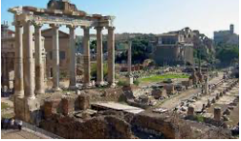
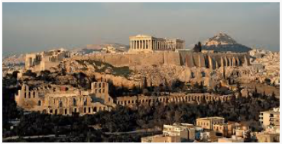
Big Ideas: Lecture 7: Slow Ideas Growth in the Past
Takeaways from this lecture:
OK: What should the takeaways from this lecture be?

Slide 20
Catch Our Breath…
Ask a couple of questions?
Make a couple of comments?
Any more readings to recommend?

Slide 21
Notes

Slide 22
Review: Long-Run Patterns: Global h, g, & n

Slide 23
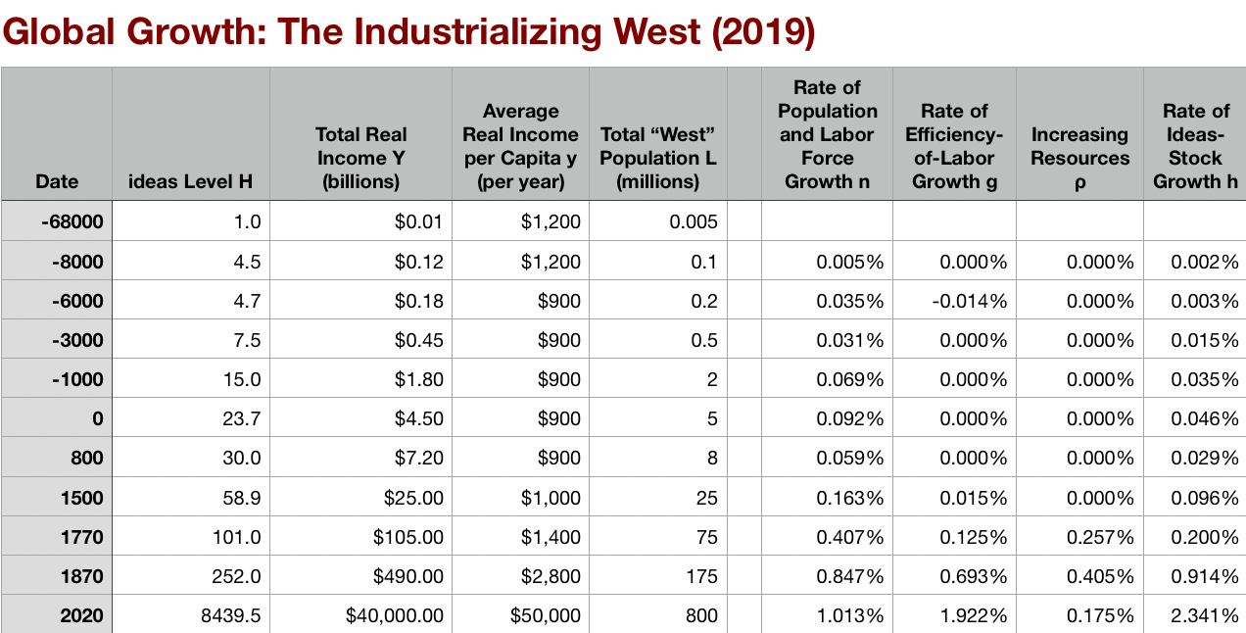
Long-Run Patterns: “Western” h, g & n
Where does the “ρ” come from?
“Ghost acreage”—conquest and resource utilization (sugar islands, timberlands, cottonlands, etc.)
Cultural expansion—Australia, Canada, New Zealand, & U.S.; Spain & Italy & Scandinavia; plus Japan, Korea, Taiwan, Hong Kong, & Singapore

Slide 24
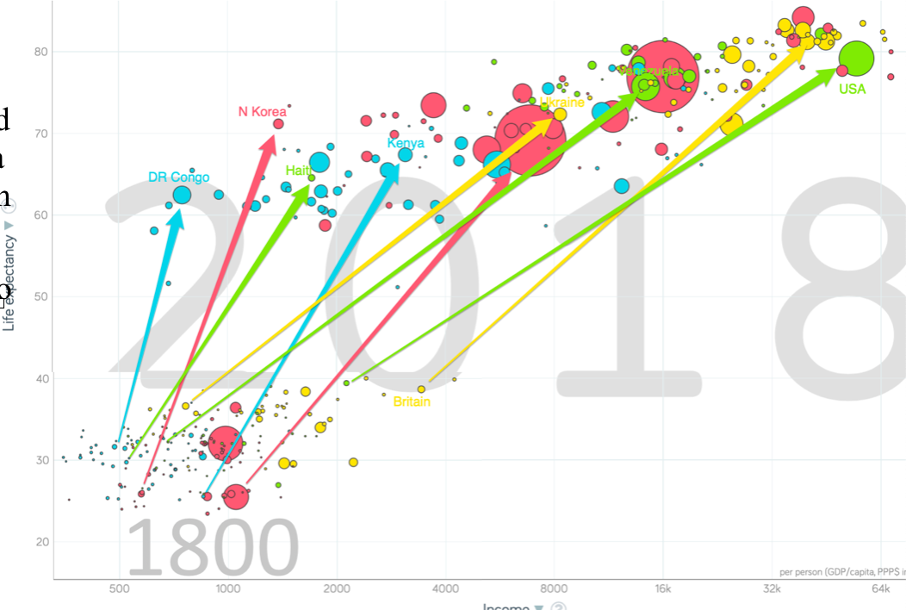
One Figure: A Great Divergence
10:20
From 1800 to 2018:
The dots start with a 3-1 spread in incomes and a 10-year spread in life expectancy.
All the arrows go up.
Some arrows—mostly those already to the right—go right fast.
Other arrows go right slowly.

Slide 25
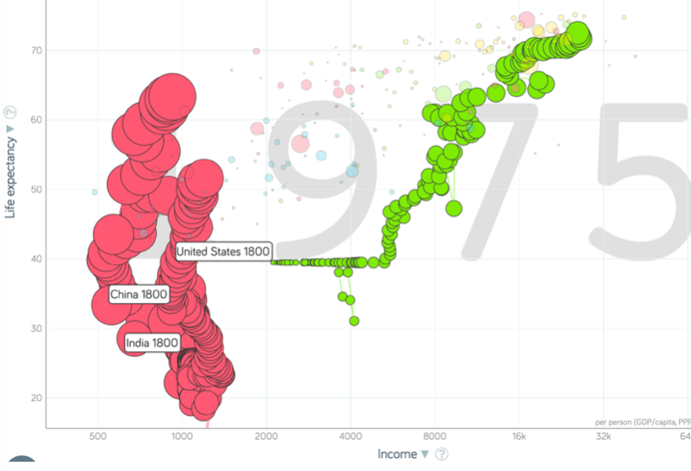
China and India and America, 1800-1975
From 1800 to 1975:
Measured living standards and productivity levels improve fourteen-fold in the United States…
…& less than 30% in China & India…
…in spite of economic, transport, and cultural globalization…
This is crazy!
A “great divergence”
Not only were China & India relatively poor in 1800, they fell further behind thereafter

Slide 26
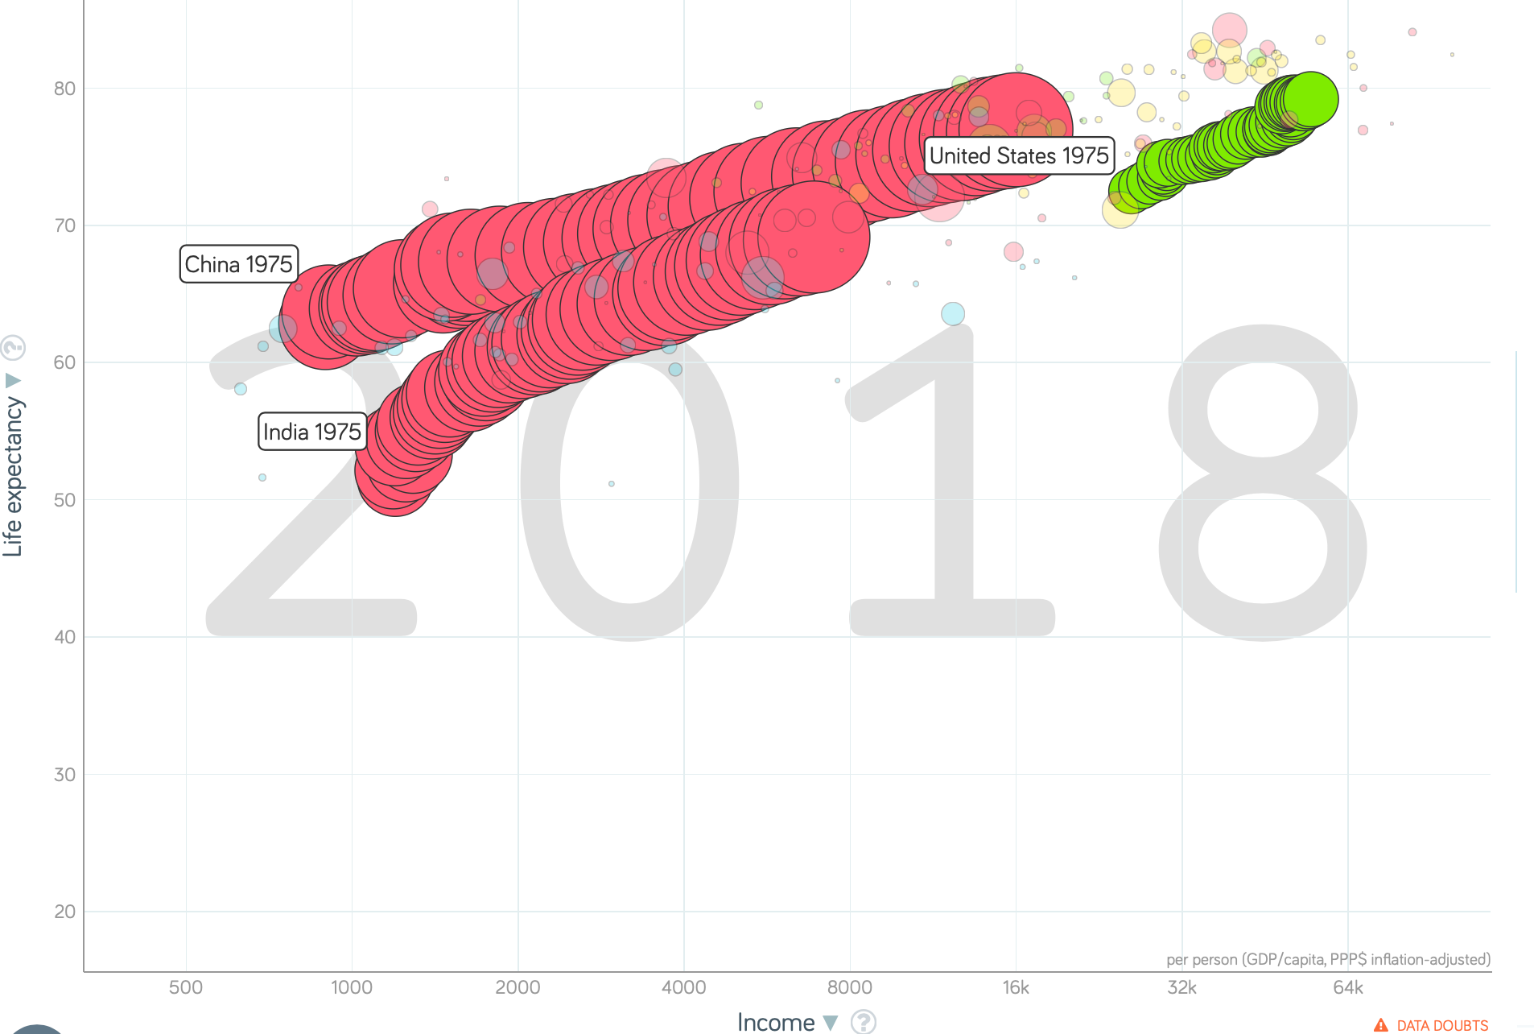
China and India and America, 1975–2018
From 1975-2018:
Measured living standards and productivity levels…
…54.9/25.9 = 2.12 in America…
…16.0/0.9 = 17.8 in China…
…6.9/1.2 = 5.8 in India…

Slide 27
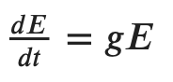
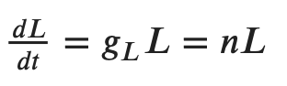
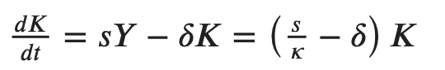
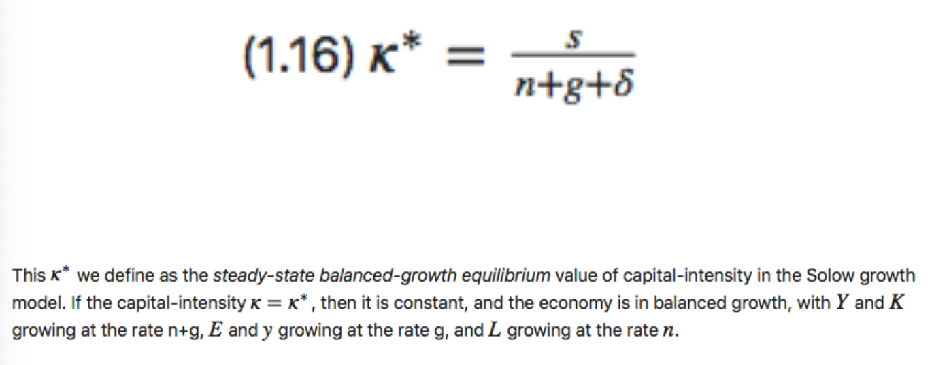
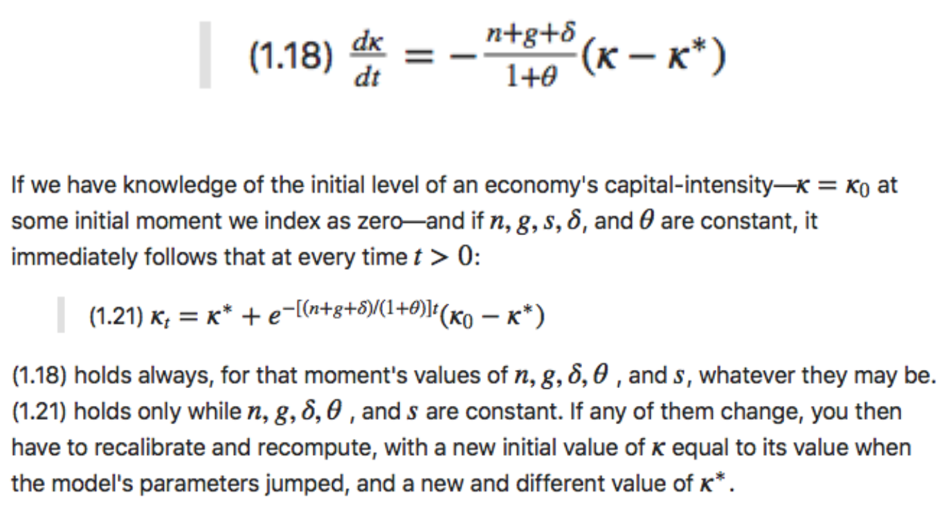
Review: Solow Model Basics
Lecture Notes: <https://www.bradford-delong.com/2020/01/lecture-notes-the-solow-growth-model-the-history-of-economic-growth-econ-135.html>

Slide 28
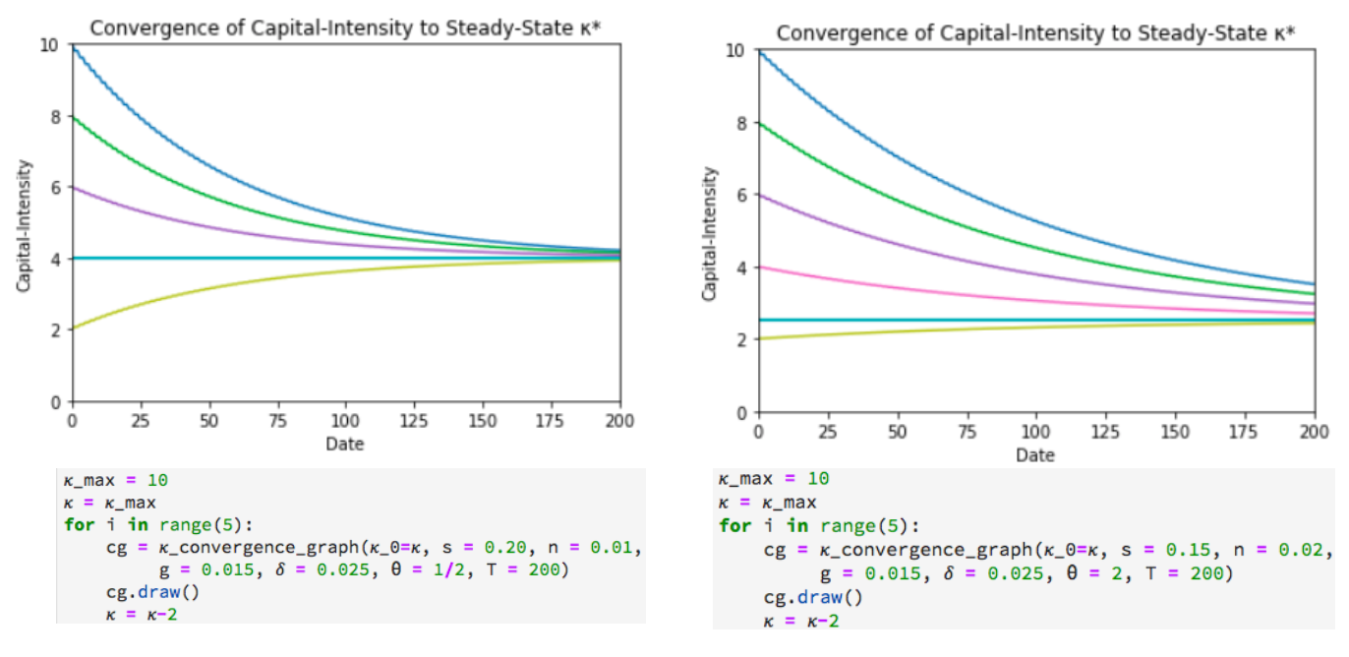
Solving the Model

Slide 29
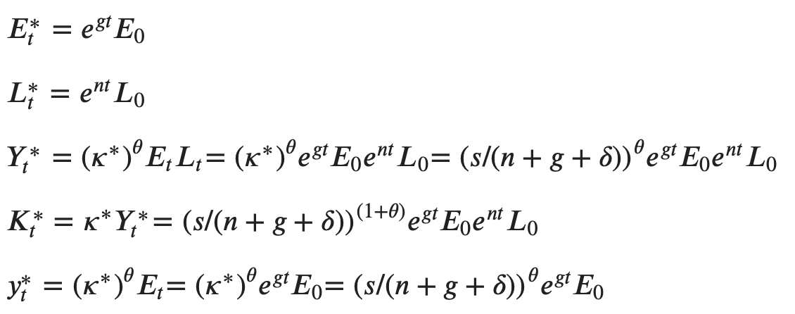
Along the Balanced-Growth Path
Everything except κ—which is constant—grows at a constant proportional rate: either n, or g, or n+g;
Labor force L grows at n
Income per worker y and the efficiency of labor E grow at g
Total income Y and the capital stock K grow at n+g

Slide 30
Review: Solow-Malthus Model Basics
How do we make sense of the fact that people were ingenious and inventive back before 1500, and yet standards of living did not increase?
Although population did increase—slowly
Other parts of the model
Balanced-growth equilibrium
Convergence to equilibrium
Lecture notes: <https://nbviewer.jupyter.org/github/braddelong/long-form-drafts/blob/master/solow-model-5-pre-industrial.ipynb>
datahub: <http://datahub.berkeley.edu/user-redirect/interact?account=braddelong&repo=long-form-drafts&branch=master&path=solow-model-5-pre-industrial.ipynb>

Slide 31
Understanding the Solow-Malthus Equilibrium: Population and Labor Force
Notes:

Slide 32
Understanding the Solow-Mathus Equilibrium: Prosperity
Notes:

Slide 33
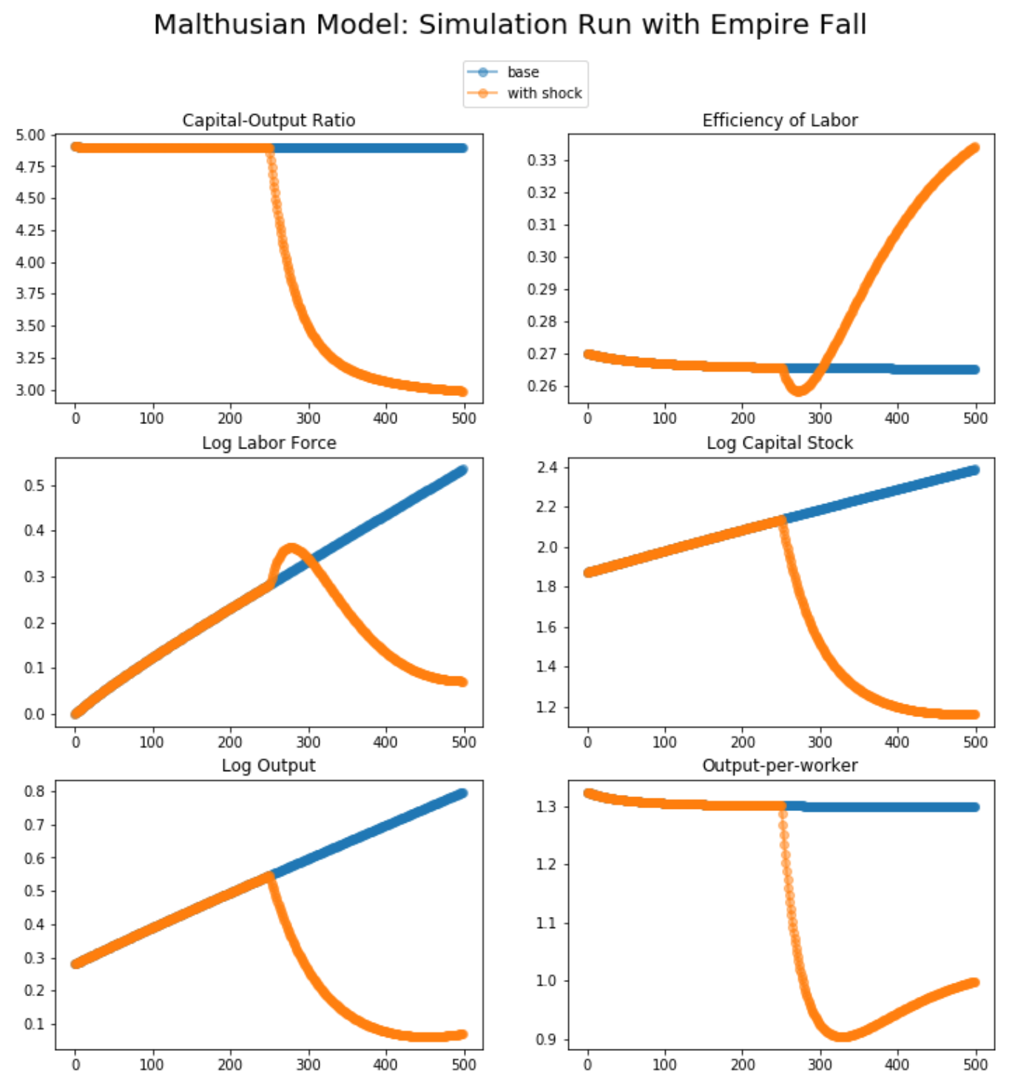
Steady-State and Along the Transition Path
The fall of an empire:
<https://nbviewer.jupyter.org/github/braddelong/LS2019/blob/master/2019-10-14-Ancient_Economies.ipynb>
A decline in inequality, taste for luxuries, and taste for urban living: Δφ = -0.25
A decline in law-and-order that produces a sharp fall in the savings rate: Δs = -0.10

Slide 34
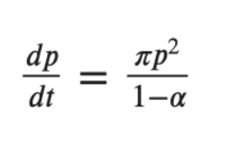
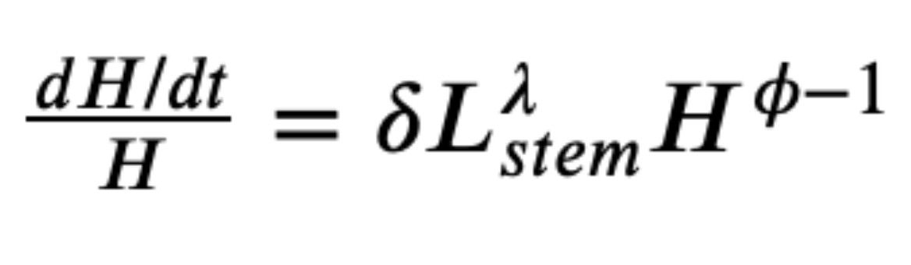
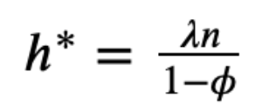
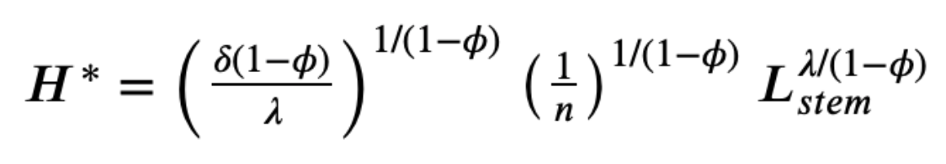
Review: Determinants of Technological and Organizational Progress
How do we make sense of the fact that technological and organizational progress was so slow back then and is so (relatively) rapid now?
Two heads are (almost) better than one
But that does not quite work
Add in additional drag from first picking low-hanging fruit
What causes the increase in Lstem?
What institutions make it profitable for nstem to be higher?
Plus:
Learning by doing
Productivity through embodiment
Technology transfer through contact

Slide 35
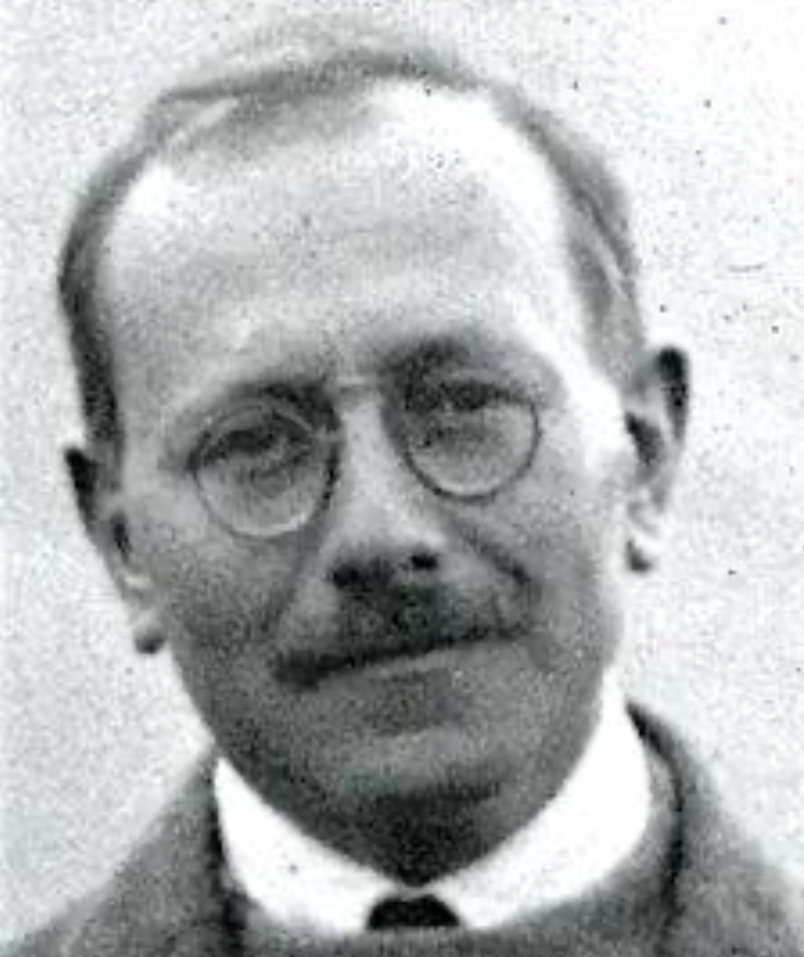
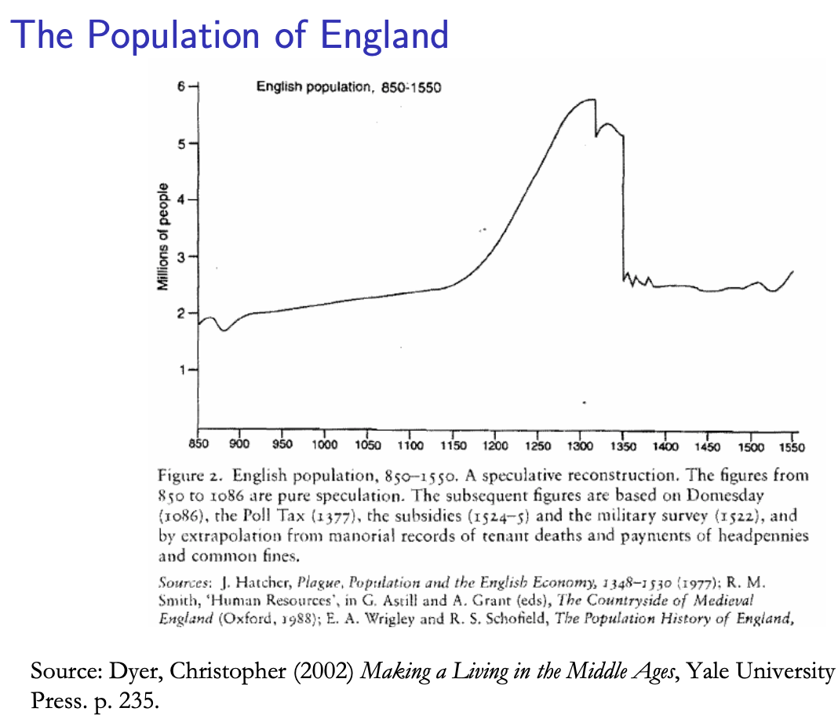
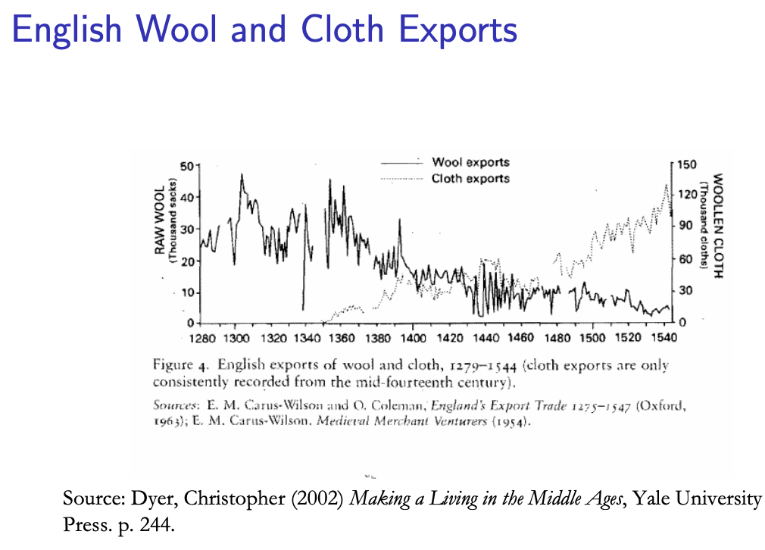
Review: Class and Conflict: at the End of the Middle Ages, Elsewhere, and Elsewhere
What was “feudalism” and how did it end?
Marc Bloch’s definitions:
A subject peasantry
Widespread use of the service tenement (i.e., the fief) instead of a salary (or of private property plus taxation and then purchase)
The supremacy of a caste of specialized warriors
Ties of obedience and protection which bind man to man
Within the warrior class, these ties assume the distinctive form called vassalage
Fragmentation of authority
Disorder and private war
But also, other forms of association, family, and state surviving…
By the late Middle Ages feudalism was a stable system
Trade and population expanded
What data we have shows the number and size of cities increasing
Slide taken from Melissa Dell

Slide 36
A Four-Cornered Fight
Kings, Lords, Commons, & Peasants:
Class alliances, class power, and class conflict…
Plus ideological legitimations…
Friedrich Engels: “Exceptional periods, however, occur when the warring classes are so nearly equal in forces that the state power, as apparent mediator, acquires for the moment a certain independence in relation to both. This applies to the absolute monarchy of the seventeenth and eighteenth centuries, which balances the nobility and the bourgeoisie against one another; and to the Bonapartism of the First and particularly of the Second French Empire, which played off the proletariat against the bourgeoisie and the bourgeoisie against the proletariat. The latest achievement in this line, in which ruler and ruled look equally comic, is the new German Empire of the Bismarckian nation; here the capitalists and the workers are balanced against one another and both of them fleeced for the benefit of the decayed Prussian cabbage Junker-squires…”
This is not just in exceptional periods…
The relative autonomy of the state is the rule, not the exception…

Slide 37
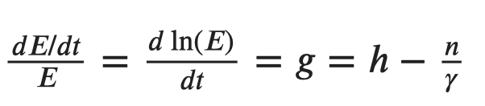
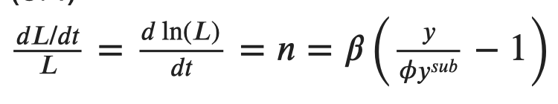
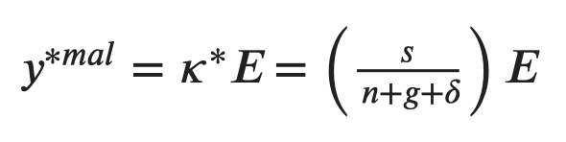
Review: Malthusian Models and Reality

Slide 38
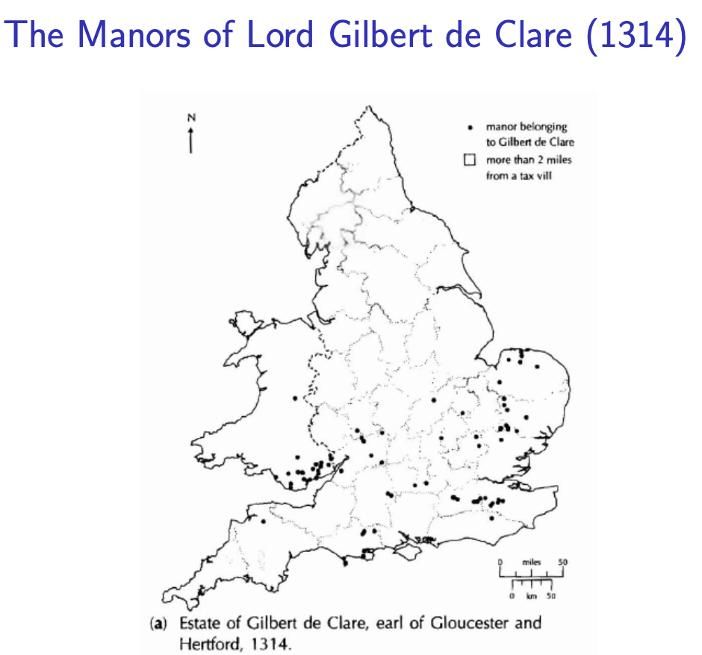
Eastern Europe and the “Second Serfdom”
The percentage of people killed in Europe was similar across space:
After the plague, landlords in Eastern Europe started to take over large tracts of land and expand their holdings, which were already larger than those in Western Europe.
Towns were weaker and less populous and rather than becoming freer, workers began to see their already existing freedoms encroached on: the Domar hypothesis at work.
This contrasts with western Europe.
Effects became especially pronounced after 1500, when Western Europe began to demand the agricultural goods which the East produced.
Eastern landlords ratcheted up their control over the labor force to expand their production.
Mecklenberg: in 1500, peasants owed only a few days service a year; by 1600 this was three days/week; children had to work for the lord for free for several years.
In Hungary, landlords legislated one day a week of unpaid labor services for each worker. In 1550 this was raised to 2 days per week. By the end of the century it was 3 days. Serfs subject to these rules made up 90% of the rural population.
What was it that allowed the Spanish settlers in Mexico to keep wages so low, when in England after the Black Death the state had been incapable of enforcing the Statue of Laborers and stopping wages from rising?
William the Conqueror rewarded his army by providing them with parceled landholdings to prevent them from becoming powerful regional warlords (save for the “marcher lords” along the Scottish and Welsh borders).
Many landholders in close proximity created intense competitive pressures for labor in the wake of the Black Death.
Slide taken from Melissa Dell

Slide 39
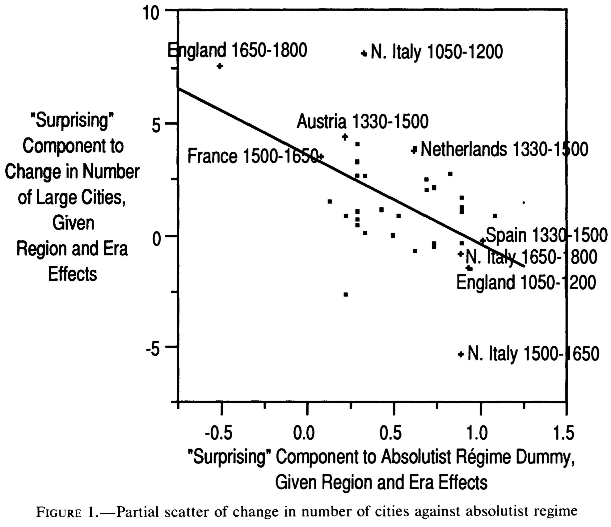
Is Malthus Right? II
At the macro level, yes; but there are lots of interesting meso- and small-scale puzzles:
In addition, measures of good government, such as proxies for constraints on the executive, are correlated with urbanization in this period.
For example, DeLong and Shleifer (1993) showed there was a strong correlation between form of government and urbanization in the pre-modern world
Charles Wilson (1967): Trade, Society, and the State: "The two areas which in 1500 represented the richest and most advanced concentrations of trade, industry and wealth were the quadrilateral formed by the Italian cities Milan, Venice, Florence and Genoa; and the strip of the Netherlands that ran from Ypres north-east past Ghent and Bruges up to Antwerp. It was not merely coincidence that these were the areas where the tradesmen of the cities had been most successful in emancipating themselves from feudal interference and in keeping at bay the newer threat of more centralized political control offered by the new monarchies. In the fleeting intervals between the storms of politics and war, men here glimpsed the material advance that was possible when tradesmen were left in peace unflattered by the attentions of strategists who regarded their activities as the sinews of war…”
Slide taken from Melissa Dell

Slide 40
Malthus: Summing Up
On the broadest scale only:
The simple Malthusian model may indeed capture some realities.
If labor markets are competitive, population growth may indeed induce a decline in wages.
Or if there is a fixed amount of land and few opportunities for labor intensive cultivation systems, a population increase may lead to a decline in output per worker.
However, the reality is typically much more messy.
How wages respond to changes in income will depend on institutions.
Thus the overwhelming likelihood that institutional or cultural factors also shaped pre-modern growth
It was not simply being dictated by the Malthusian relationship between births, deaths, and income.
Slide taken from Melissa Dell

Slide 41
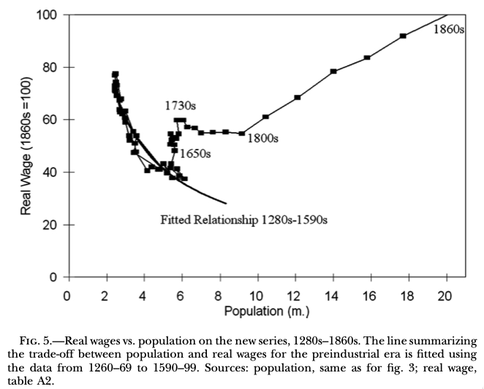
Review: “Subsistence”

Slide 42
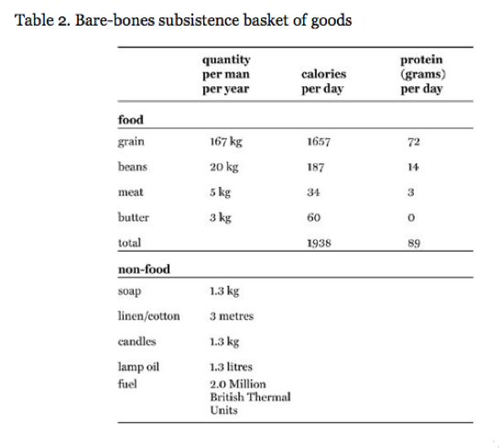
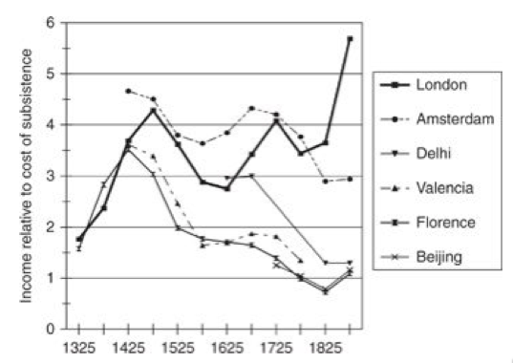
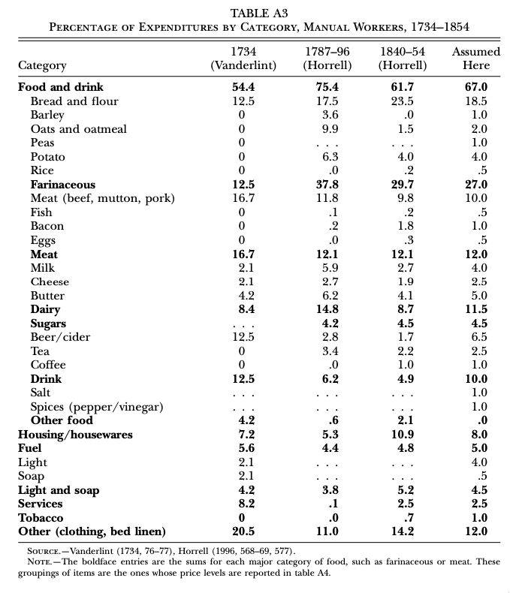
“Bare-Bones”
From Clark & Allen:
"Manual workers”—70% of median, 50% of average income
In 1800: the English population in 1800 is a very rich pre-industrial population
70% of spending spent on food
30-40% grains
20% meat and dairy
“Bare-bones” subsistence
Cities: Malthus rules, but it takes centuries—and other things can and do happen

Slide 43
Review: Pre-Industrial “Efflorescences”
Ideas courtesy of Jack Goldsmith, Daron Acemoglu and James Robinson:
The Malthusian model misses a great deal of the interesting action prior to the Industrial Revolution.
An alternative explanation for why there was no long-run trend in living standards is the theory of ‘efflorescence and decline’
I organize my thoughts about this with the two Malthusian equations, and with their bunch of variables and parameters: h, γ, β, φ, y^{sub}, s, δ, θ, and H that together determine y^{*mal} and L^{*mal}
This is best thought of as a filing system for factors that may be important—given the importance of both capital and labor efficiency, the roles of ideas and of resources in producing labor efficiency, and Malthusian population dynamics, these are the things you should look at

Slide 44
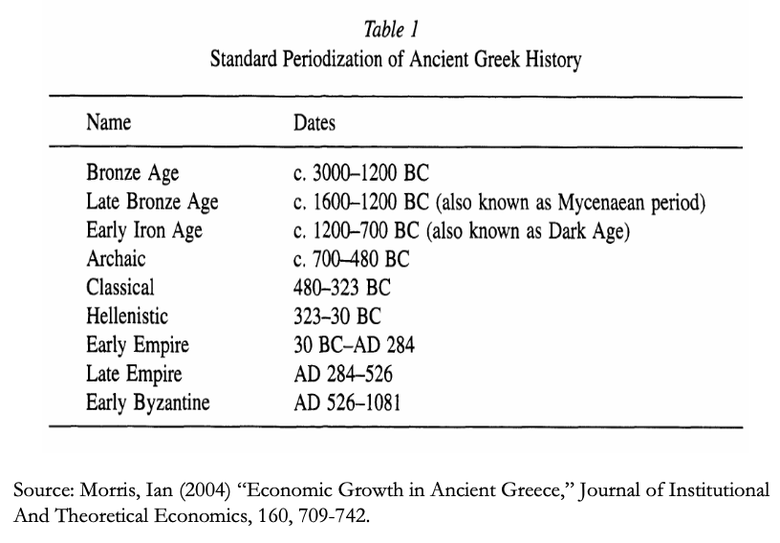
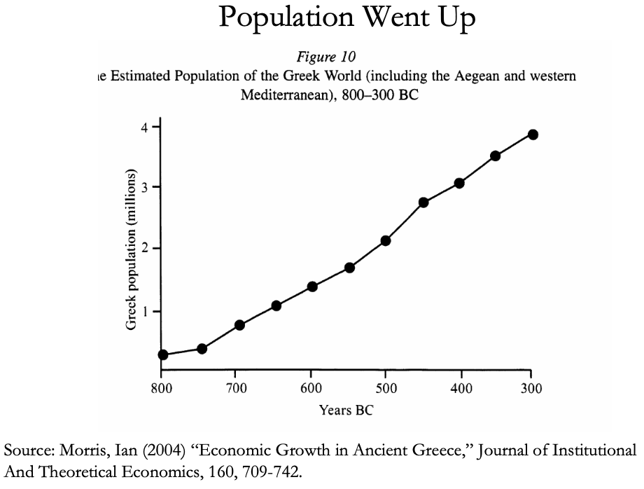
The Classical Greek Efflorescence
Emerging out of the Iron Dark Age of -1200 to -800:
When the Greek city states emerged they did so with functional systems of governance which provided public goods, such as security for trade and investment.
This initiated a period of sustained increases in living standards.
While Ancient Greece did have a period of democracy, it was relative short (less than 200 years) compared to the duration of the polity and most citizens - slaves, poor citizens who couldn’t afford their tax bill, women - could not participate.
Greek institutions (rules according to which the society was organized) tended to be “extractive.” For example, the economy was largely based upon slavery.
Slide taken from Melissa Dell

Slide 45
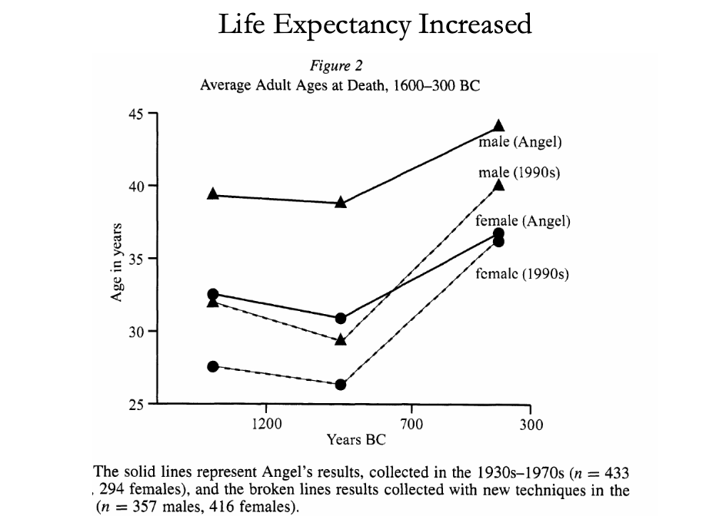
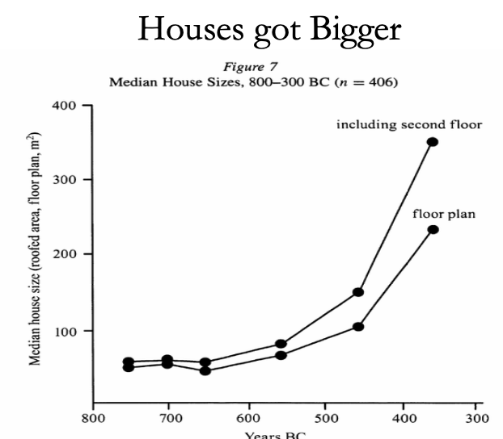
The Classical Greek Efflorescence II
“Developmental” or “Extractive”?
Extractive political institutions concentrate political power in the hands of some group who can use that power to redistribute wealth and income to themselves. This resulting concentration of wealth tends to reinforce the initial set of political institutions.
Roving bandits or stationary bandits?
Acemoglu and Robinson hypothesize that growth was not sustained in ancient societies because their institutions were extractive, and extractive institutions are incompatible with sustaining growth in the long run.
They argue that this is because extracting resources creates conflicts over who will control those resources, and it may also induce rebellion from below.
In either case political instability can bring the government and economy down.
Slide taken from Melissa Dell

Slide 46
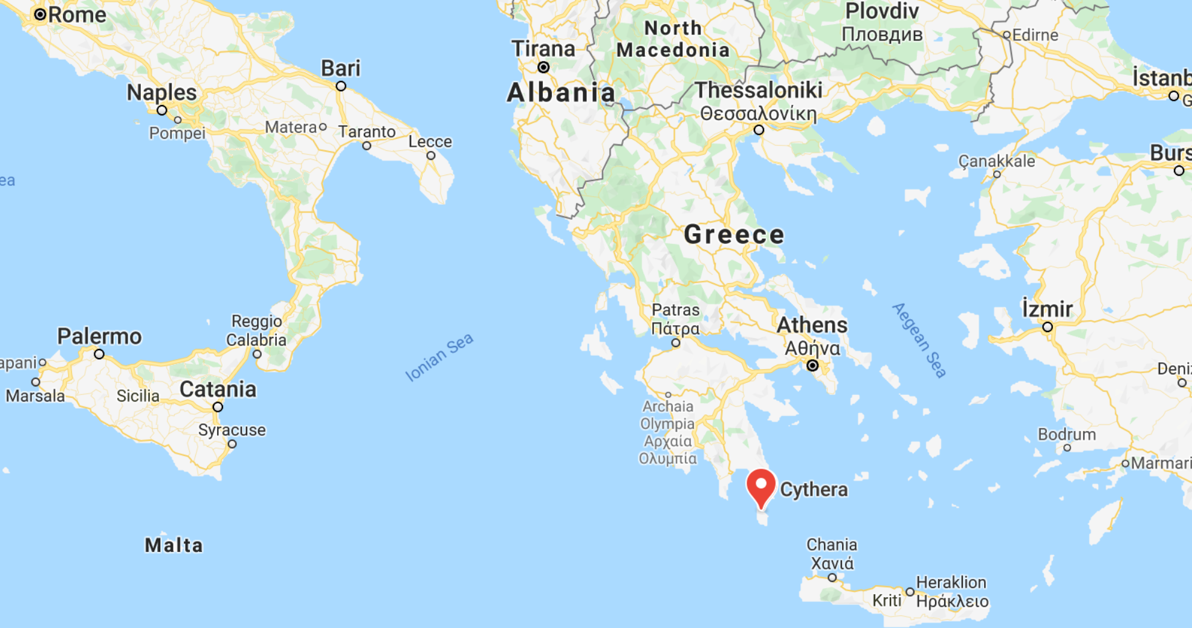
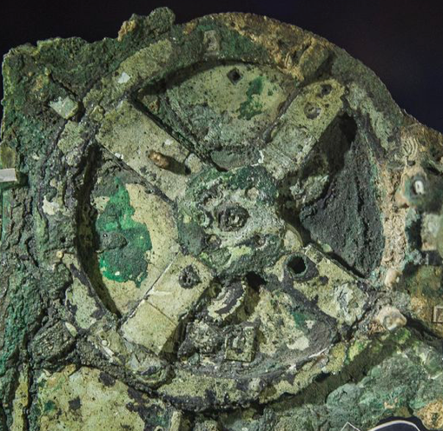
The Anti-Kythera Mechanism
What is this?
Built between -150 and -70. Rhodes13” x 7” x 4“ wooden box
Gears—largest 5” in diameter
Inscriptions
Wikipedia: “37 gear wheels enabling it to follow the movements of the Moon and the Sun through the zodiac, to predict eclipses and even to model the irregular orbit of the Moon, where the Moon's velocity is higher in its perigee than in its apogee. This motion was studied in the 2nd century BC by astronomer Hipparchus of Rhodes, and it is speculated that he may have been consulted in the machine's construction. The knowledge of this technology was lost at some point in antiquity. Similar technological works later appeared in the medieval Byzantine and Islamic worlds, but works with similar complexity did not appear again until the development of mechanical astronomical clocks in Europe in the fourteenth century…”

Slide 47
The Anti-Kythera Mechanism II
What is this?
Brian Resnick: “A main gear would move to represent the calendar year, and would, in turn, move many separate smaller gears to represent the motions of the planets, sun, and moon. So you could set the main gear to the calendar date and get approximations for where those celestial objects would be in the sky on that date…. You, as a user, could input a few simple variables and it would yield a flurry of complicated mathematical calculations.… All the user had to do was enter the main date on one gear, and through a series of subsequent gear turns, the mechanism could calculate things like the angle of the sun crossing the sky. (For some reference, mechanical calculators—which used gear ratios to add and subtract—didn’t arrive in Europe until the 1600s)…”

Slide 48
Cicero (-54): De Re Publica
“With the exception of the dream of Scipio, in the last book, the whole treatise was lost till the year 1822, when the librarian of the Vatican discovered a portion of them among the palimpsests in that library. What he discovered is translated here; but it is in a most imperfect and mutilated state. The form selected was that of a dialogue, in imitation of those of Plato…”
I.XIV:
Then Philus said: “I am not about to bring you anything new, or anything which has been thought over or discovered by me myself. But I recollect that Caius Sulpicius Gallus, who was a man of profound learning, as you are aware, when this same thing was reported to have taken place in his time, while he was staying in the house of Marcus Marcellus, who had been his colleague in the consulship, asked to see a celestial globe which Marcellus’s grandfather had saved after the capture of Syracuse from that magnificent and opulent city, without bringing to his own home any other memorial out of so great a booty; which I had often heard mentioned on account of the great fame of Archimedes; but its appearance, however, did not seem to me particularly striking. For that other is more elegant in form, and more generally known, which was made by the same Archimedes, and deposited by the same Marcellus in the Temple of Virtue at Rome.
“But as soon as Gallus had begun to explain, in a most scientific manner, the principle of this machine, I felt that the Sicilian geometrician must have possessed a genius superior to anything we usually conceive to belong to our nature. For Gallus assured us that that other solid and compact globe was a very ancient invention, and that the first model had been originally made by Thales of Miletus. That afterward Eudoxus of Cnidus, a disciple of Plato, had traced on its surface the stars that appear in the sky, and that many years subsequently, borrowing from Eudoxus this beautiful design and representation, Aratus had illustrated it in his verses, not by any science of astronomy, but by the ornament of poetic description. He added that the figure of the globe, which displayed the motions of the sun and moon, and the five planets, or wandering stars, could not be represented by the primitive solid globe; and that in this the invention of Archimedes was admirable, because he had calculated how a single revolution should maintain unequal and diversified progressions in dissimilar motions.
“In fact, when Gallus moved this globe, we observed that the moon succeeded the sun by as many turns of the wheel in the machine as days in the heavens. From whence it resulted that the progress of the sun was marked as in the heavens, and that the moon touched the point where she is obscured by the earth’s shadow at the instant the sun appears opposite….
Scipio: “I had myself a great affection for this Gallus, and I know that he was very much beloved and esteemed by my father Paulus. I recollect that when I was very young, when my father, as consul, commanded in Macedonia, and we were in the camp, our army was seized with a pious terror, because suddenly, in a clear night, the bright and full moon became eclipsed. And Gallus, who was then our lieutenant, the year before that in which he was elected consul, hesitated not, next morning, to state in the camp that it was no prodigy, and that the phenomenon which had then appeared would always appear at certain periods, when the sun was so placed that he could not affect the moon with his light…”

